Slide 1
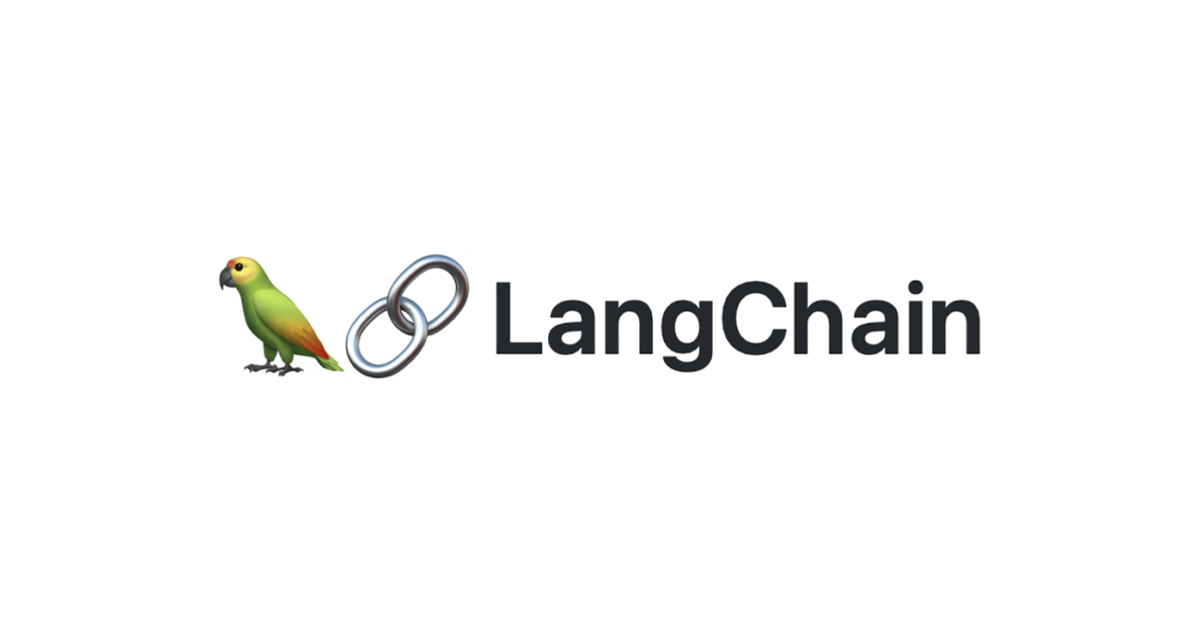
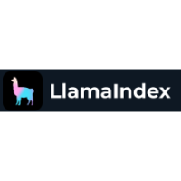
+
LANGCHAIN & LLAMAINDEX
PRESENTATION BY ZULELE

Slide 2
TABLE OF CONTENTS
01
04
What is LangChain?
What is LlamaIndex?
02
05
Components of LangChain
LlamaIndex Demo
03
How to use LangChain?

Slide 3
WHAT IS LANGCHAIN?
LangChain is a framework for developing applications powered by language models.
It enables applications that are:
Data-aware: connect a language model to other sources of data
Agentic: allow a language model to interact with its environment

Slide 4
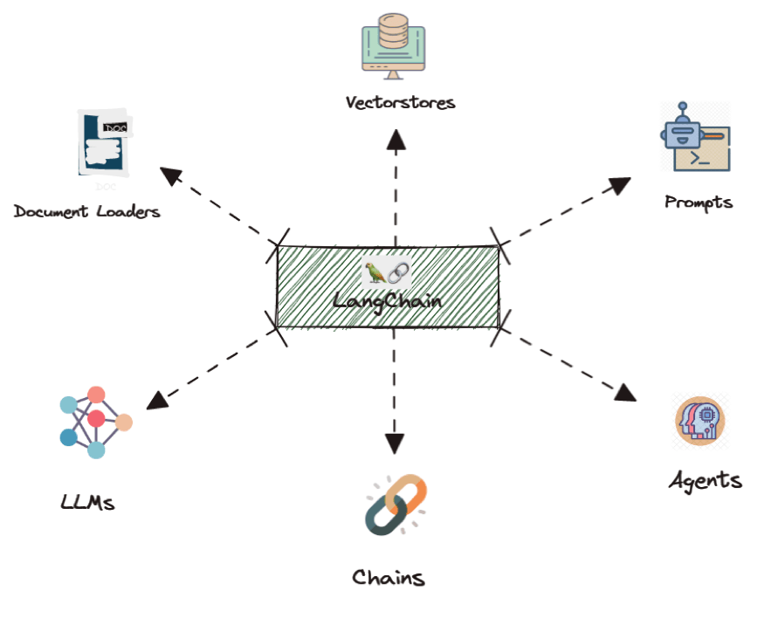
COMPONENTS OF LANGCHAIN
Model I/O​
Interface with language models
Data connection​
Interface with application-specific data
Chains​
Construct sequences of calls
Agents​
Let chains choose which tools to use given high-level directives
Memory​
Persist application state between runs of a chain

Slide 5
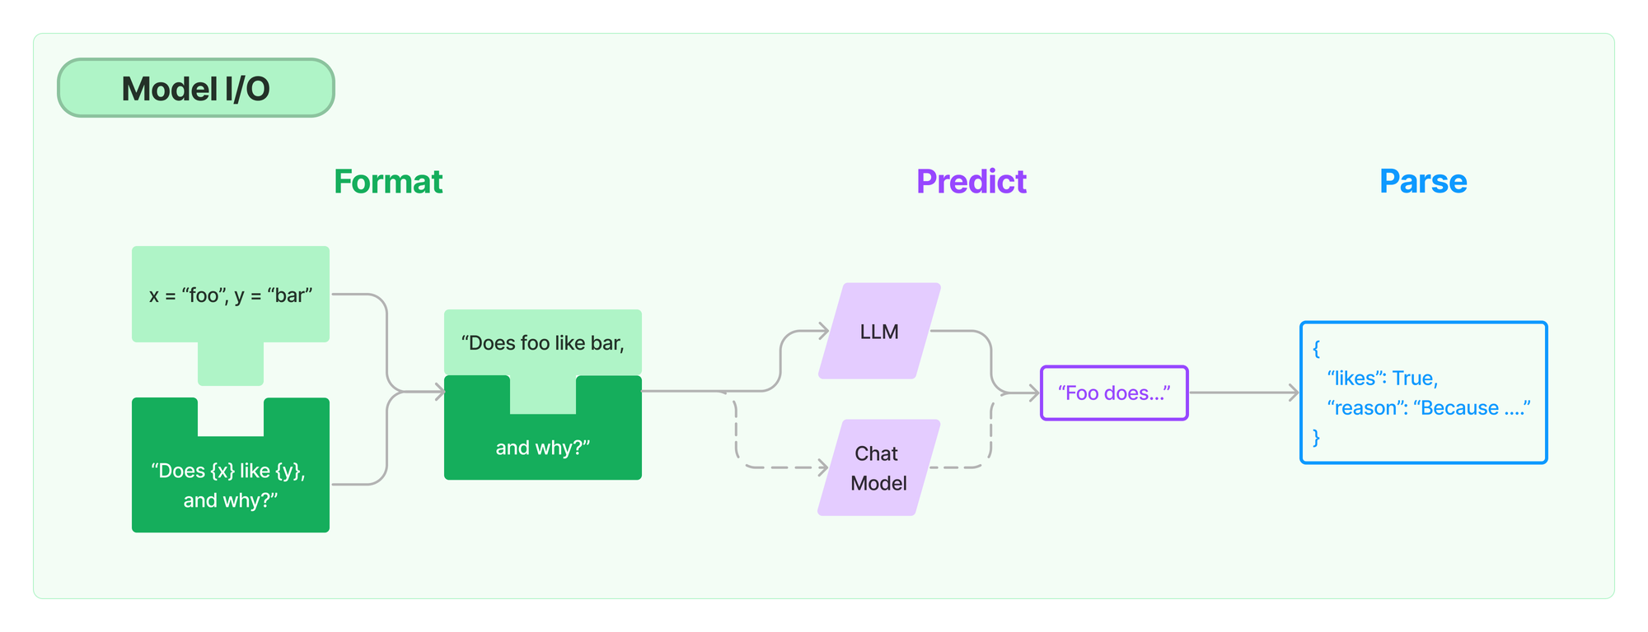
MODEL I/O
Prompts: Templatize, dynamically select, and manage model inputs
Language models: Make calls to language models through common interfaces
Output parsers: Extract information from model outputs

Slide 6
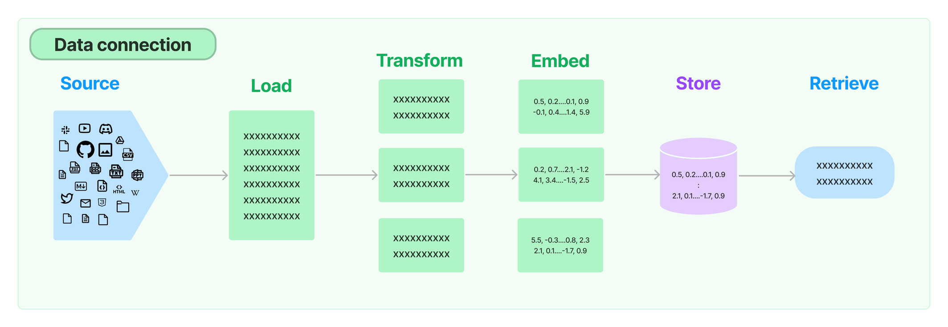
DATA CONNECTION
Document loaders: Load documents from many different sources
Document transformers: Split documents, convert documents into Q&A format, drop redundant documents, and more
Text embedding models: Take unstructured text and turn it into a list of floating point numbers
Vector stores: Store and search over embedded data
Retrievers: Query your data

Slide 7
CHAINS
Using an LLM in isolation is fine for simple applications, but more complex applications require chaining LLMs - either with each other or with other components.
Use Case:
Create a chain that takes user input, formats it with a PromptTemplate, and then passes the formatted response to an LLM.

Slide 8
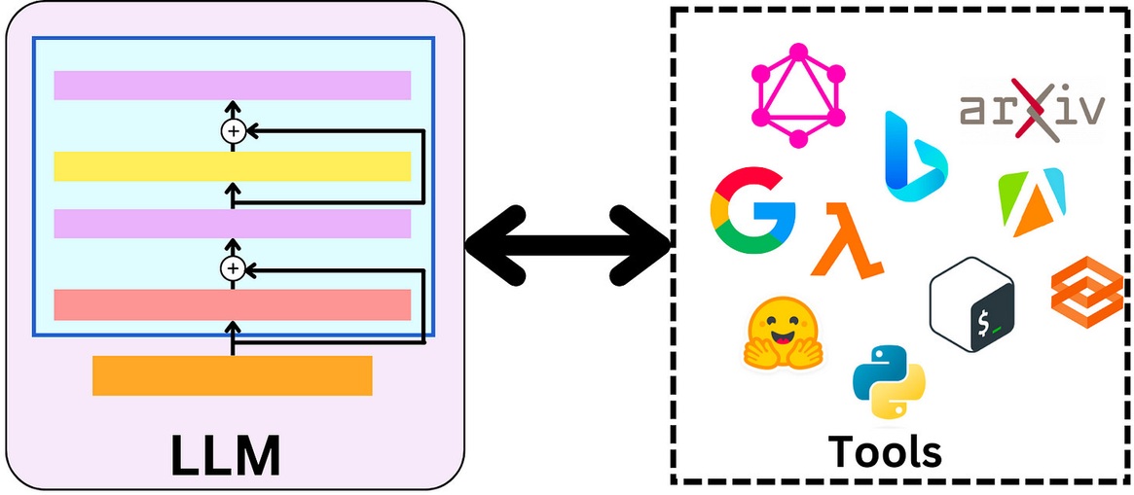
AGENTS
The core idea of agents is to use an LLM to choose a sequence of actions to take. In chains, a sequence of actions is hardcoded (in code). In agents, a language model is used as a reasoning engine to determine which actions to take and in which order.

Slide 9
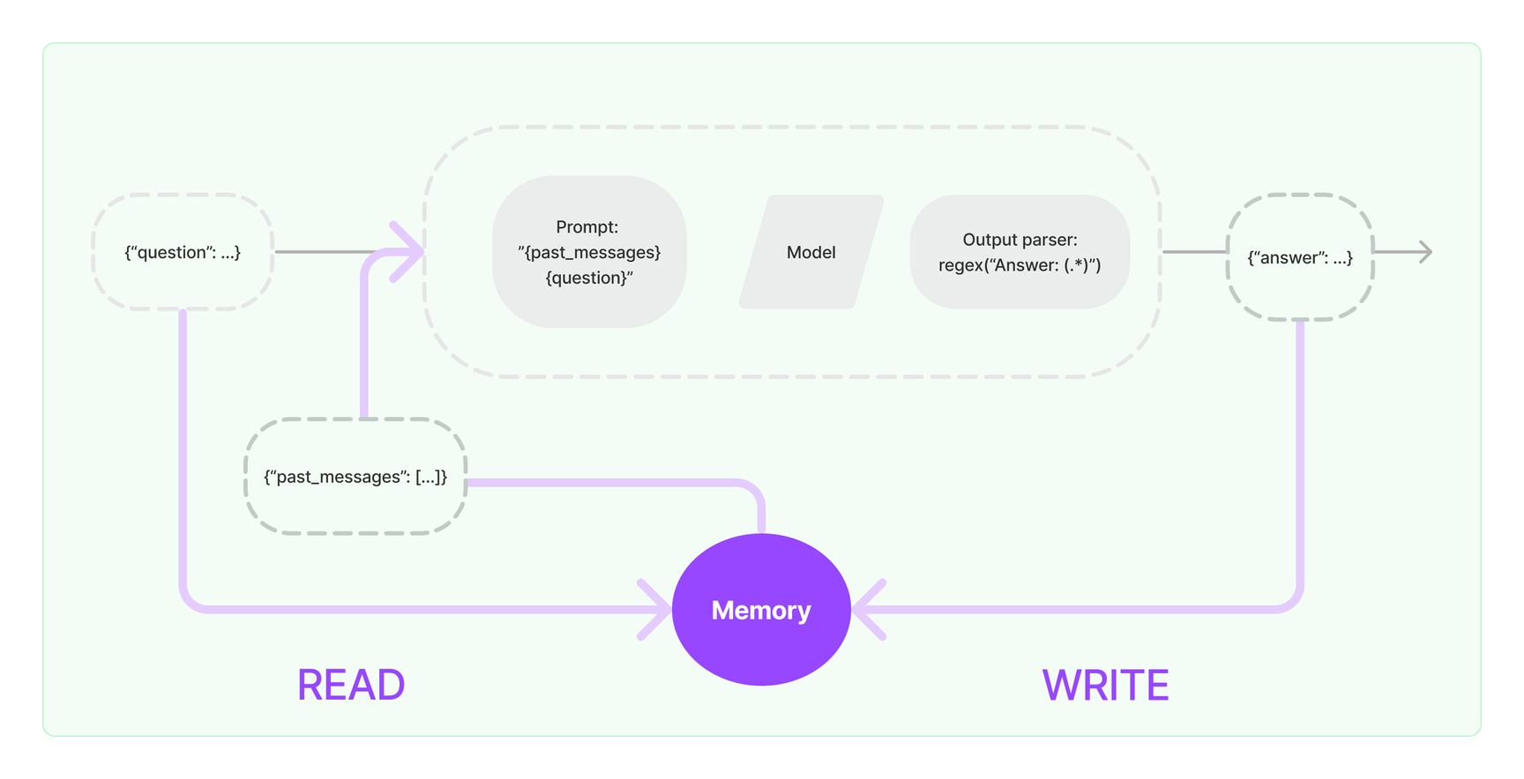
MEMORY
Most LLM applications have a conversational interface. An essential component of a conversation is being able to refer to information introduced earlier in the conversation.

Slide 10
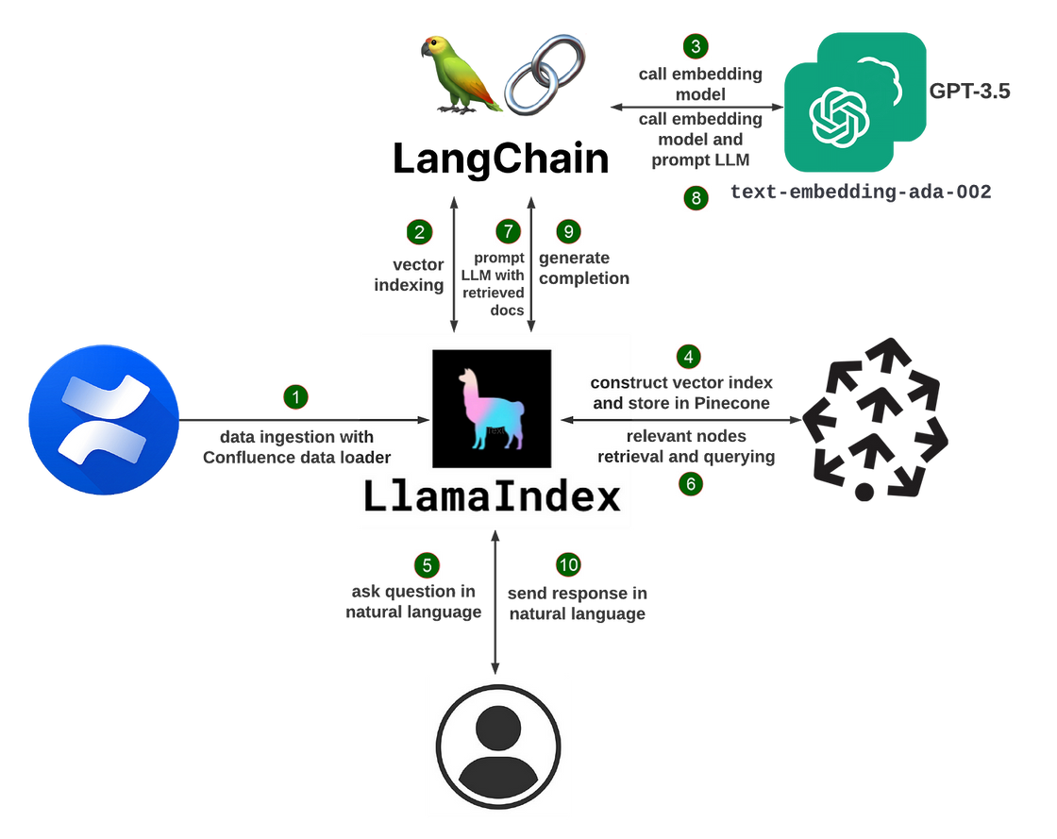
LLAMAINDEX
LlamaIndex (formerly GPT Index) is a data framework for connecting custom data sources to large language models

Slide 11
QUESTIONS?
THANK YOU :)

